Slide 1

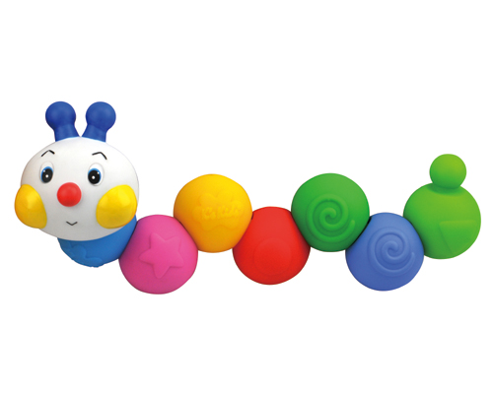
Chain-an-inchworm
Toy Name
Chain-an-inchworm
Manufacturer
K’s Kids
Age
6 – 12 months
Parts
1 Inchworm Head
12 beads
Develop Skills
Fine Motor
Imagination
Social
Cognitive
How it Works
Anak-anak bisa melatih kemampuan motorik dan logika mereka dengan menghubungkan bagian-bagian untuk membentuk binatang cacing.
-
Children can train their fine motor and logic skills as they link the pieces together to build inchworms.
How To Clean
Simply clean using a cloth that has been sprayed with non-toxic anti bacterial solution
Warning
Store in a dry place
Keep out of direct sunlight

